Slide 1


Hello
W RLD
Paras Sharma
@paraazz

Slide 2
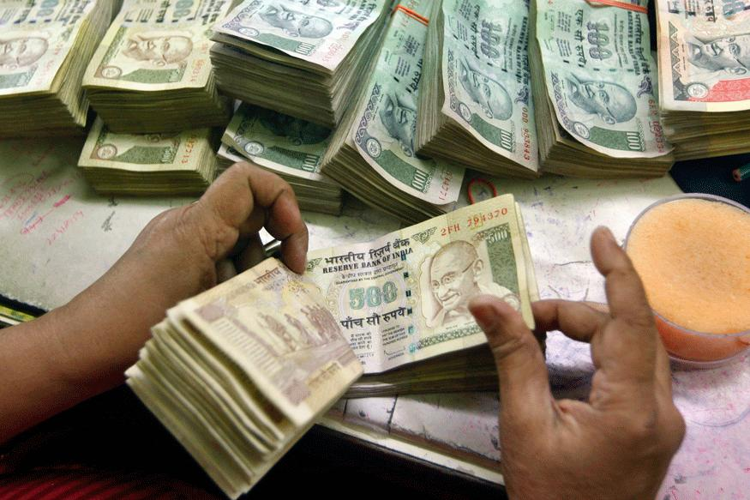
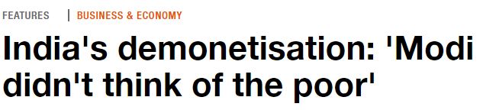
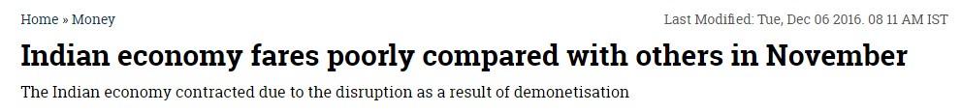
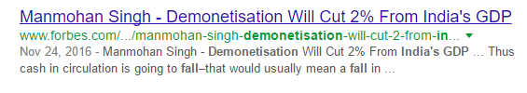
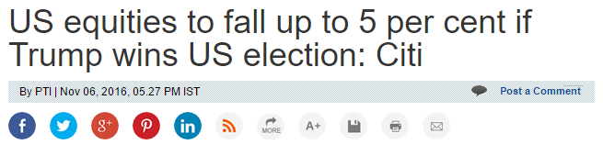
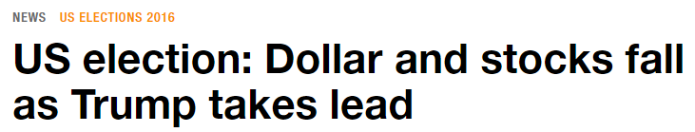

Slide 3

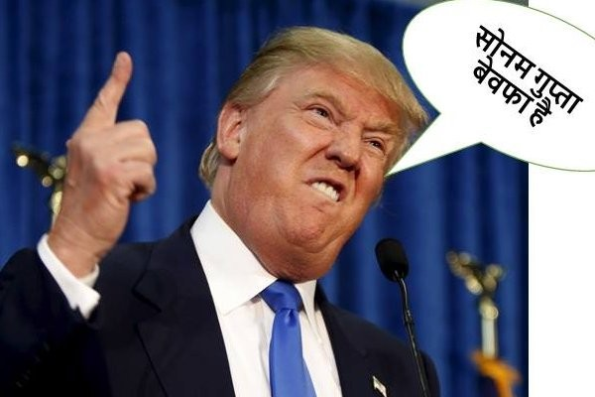
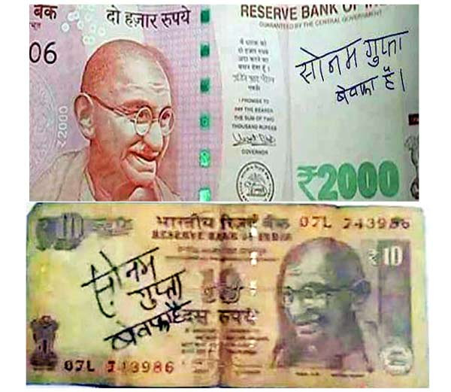
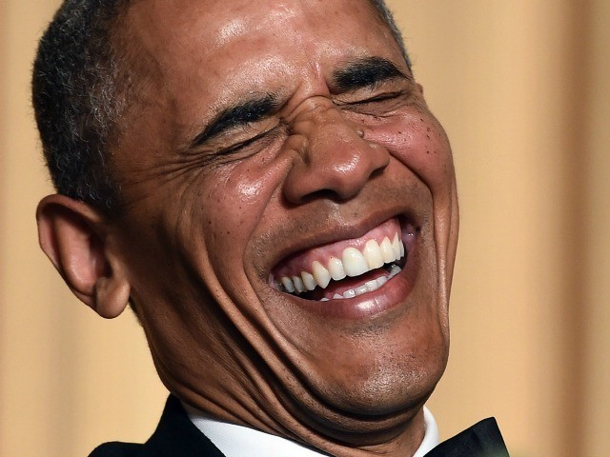

Slide 4
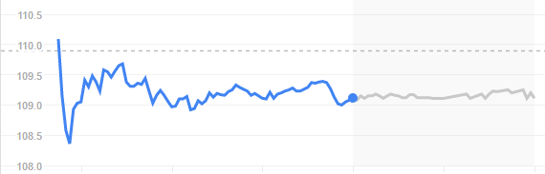
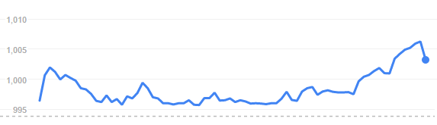
Stock Exchange
History Concept Scenario

Slide 5

History

Slide 6


In 1602 Dutch East India Company became first publicly traded Company

Slide 7
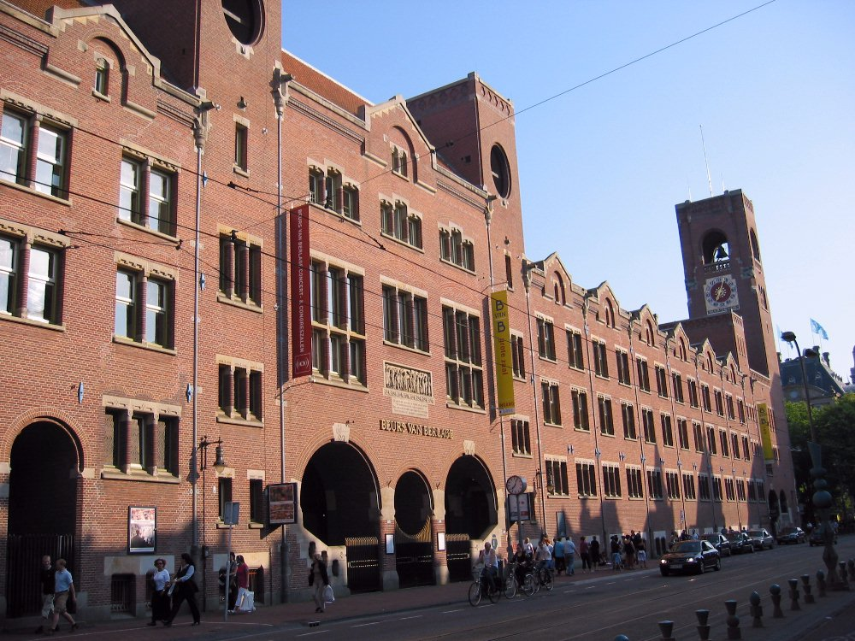
Amsterdam Stock Exchange

Slide 8

Till 1825 Stock Exchange was banned from issuing shares

Slide 9

Established in 1801 Was not able to trade shares due to ban.

Slide 10
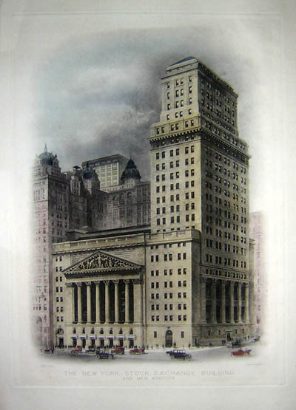
Creation of New York Stock Exchange in 1817, An important moment in History

Slide 11
“The London Stock Exchange was the main stock market for Europe, while the New York Stock Exchange was the main exchange for America and the world.”

Slide 12

Concept

Slide 13
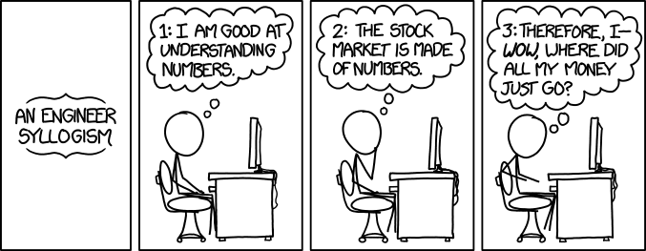
Stock Market is as simple as Maths

Slide 14

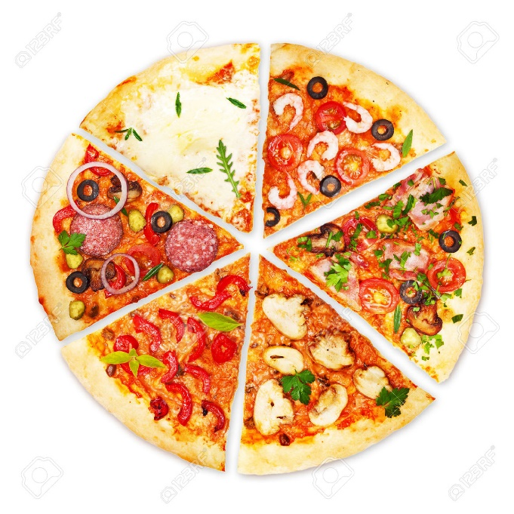
Yummy!
Stock or Share

Slide 15

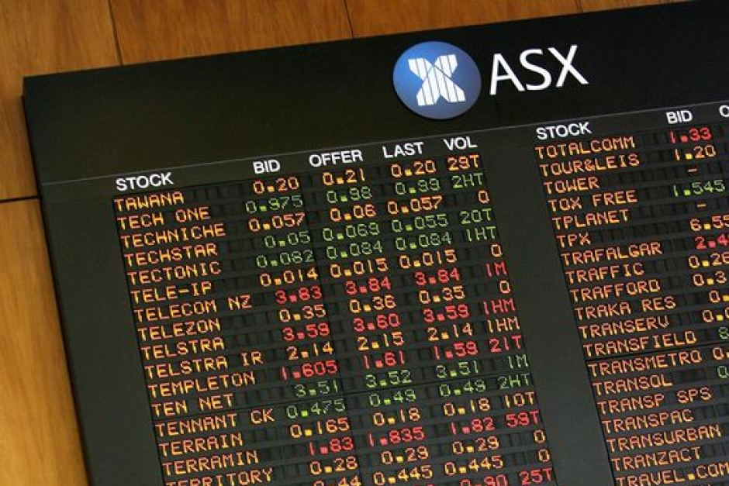
IPO Initial Public Offering.
Listing Getting enrolled at Exchange

Slide 16

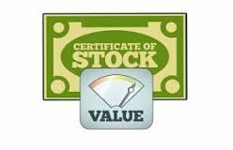
A person who buys and sells stocks for others
Stock Value
is earning per share.

Slide 17

Buying
Losing
Selling
Earning

Slide 18
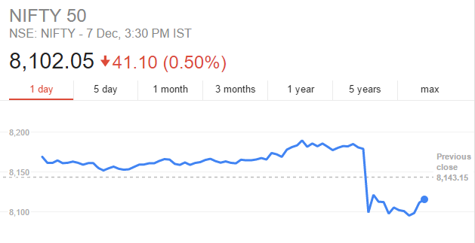
Sensex: Sensitive-Index
Nifty: National Index for fifty.

Slide 19
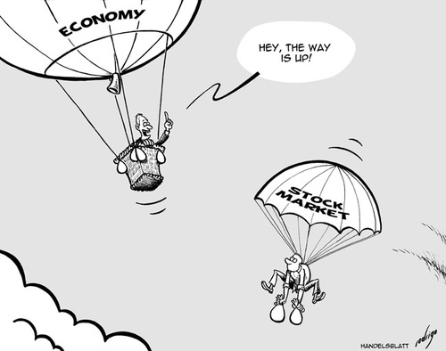
Economy and the Stock Exchange

Slide 20
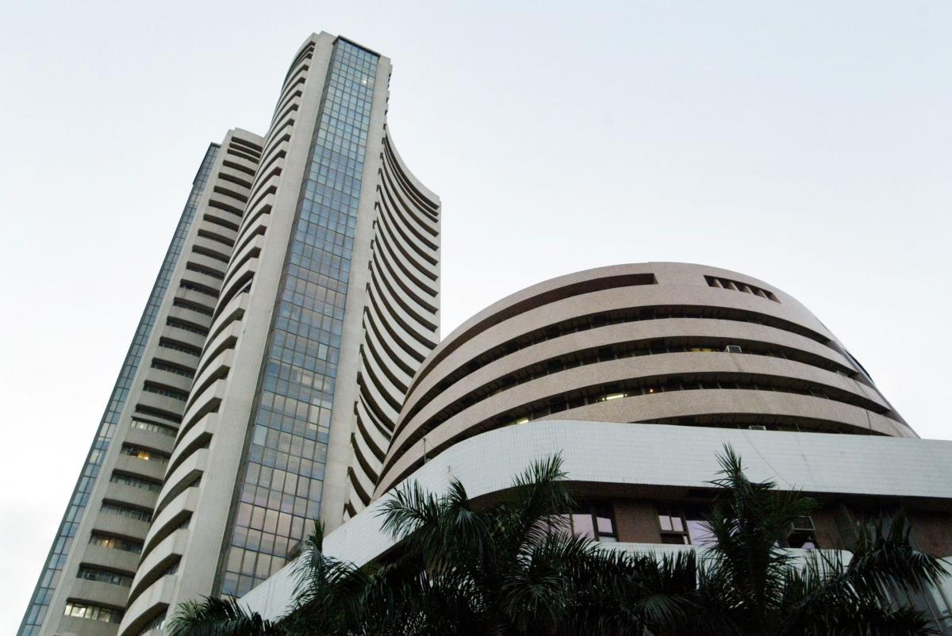
Current Scenario

Slide 21
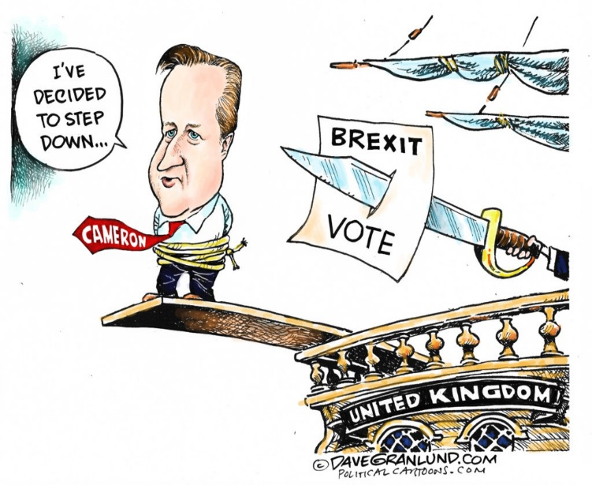
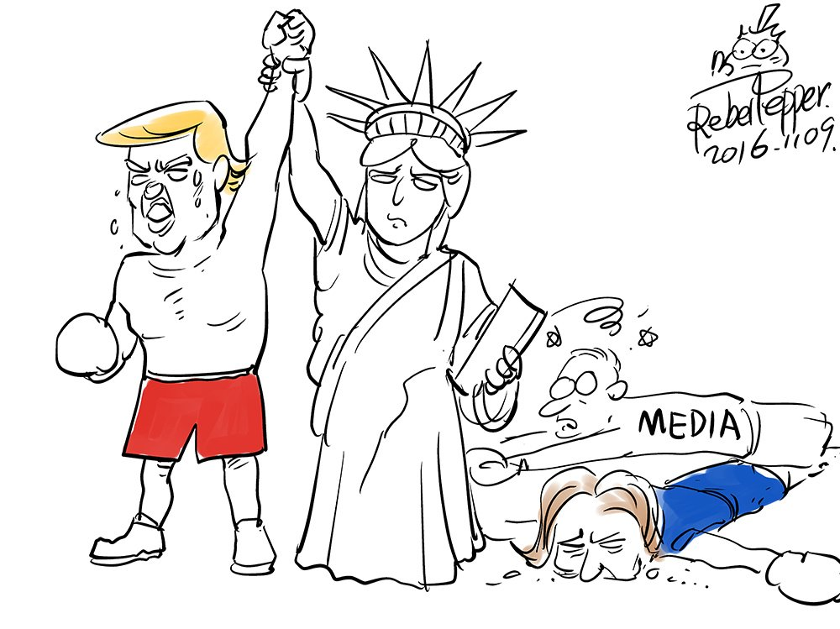
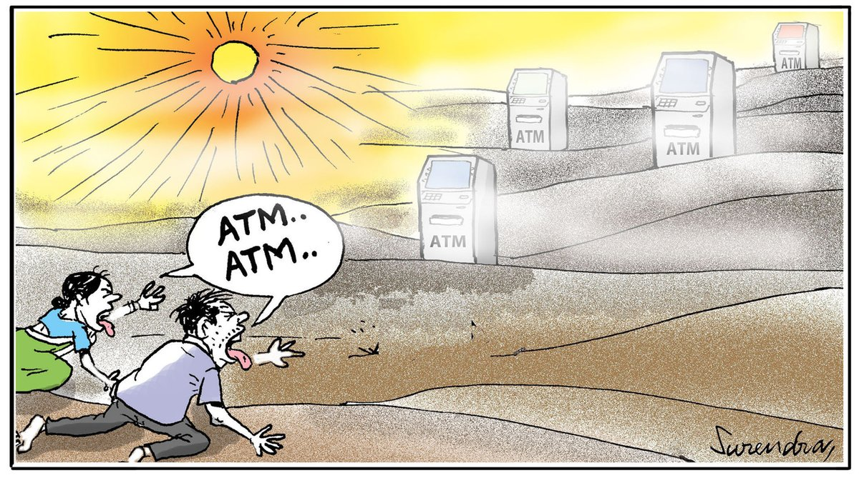
Brexit, Trump and Note-Ban!

Slide 22
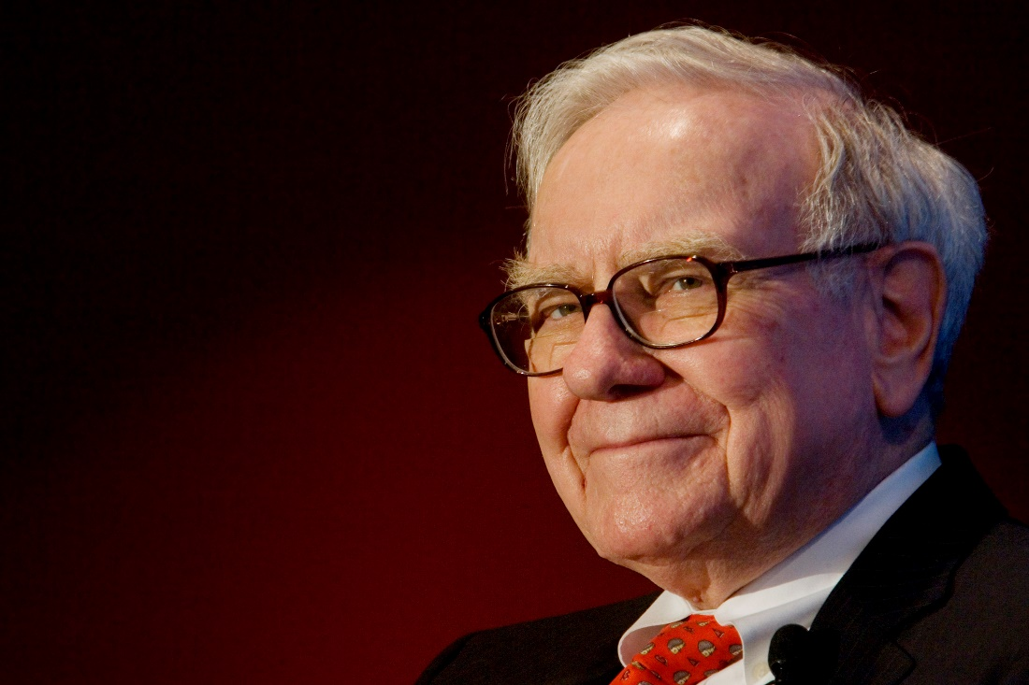
"In the short term, the market is a voting machine. But, in the long term, the market is a weighing machine". – Warren Buffett

Slide 23

Thanks

Slide 24
Sources:
Gensler, Lauren. “Stock Market Slingshots Higher After Trump Victory Sparked Overnight Plunge”. Forbes NOV 9, 2016.Web.
Kukowski, Mathew. “History of StockMarket”. Bebussinessed.Web.
Mitchel, Cory. “How stock Exchange works”. Investopedia, 21 April 2016.Web
Molloy, Mark. “Best Cartoons after trump victory”. Telegraph, 10 November, 2016.Web.
Pettinger, Tejwan. “Relation Between stock market and economy”. EconomicsHelp, 18 July, 2016.Web.
“Stock Market”.Wikipedia.Web.
Viswanathan, Balaji.”How stock Market works? Who decides stock prices?”.Quora, May 10, 2013.Web.
“Engineer Syllogism”: http://xkcd.com/1570/.Image.
“Market Watch”: https://xkcd.com/1600/.Image.

